Slide 1
Role Playing Game
Kyriakou Ioanna
dpsd 18058

Slide 2
CHARACTERS

Slide 3



Player
NPC
Enemy

Slide 4
LEVELS

Slide 5
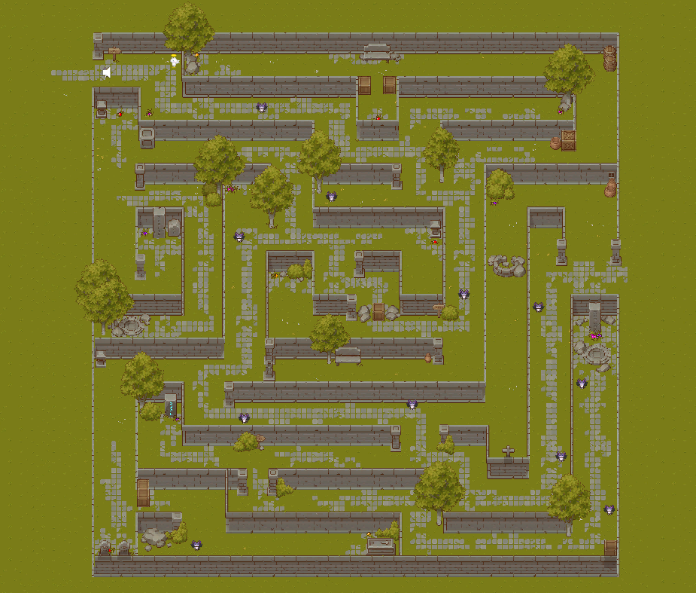
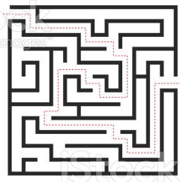
Level 1

Slide 6
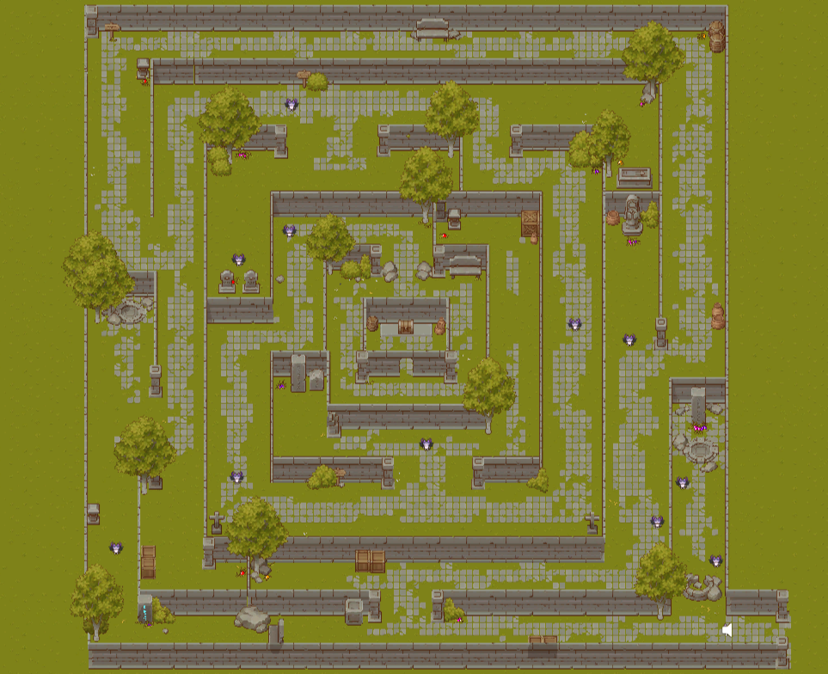
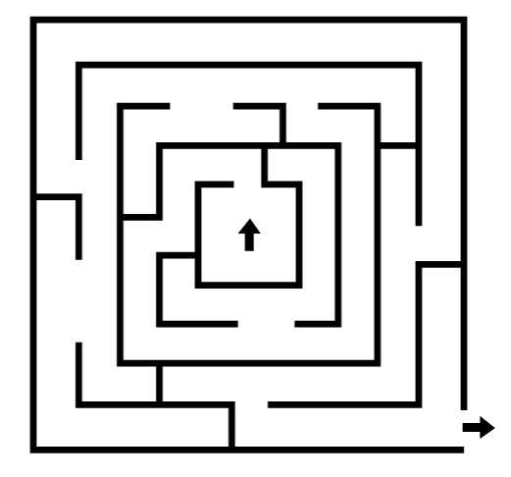
Level 2

Slide 7
WORLD INTERACTIONS

Slide 8
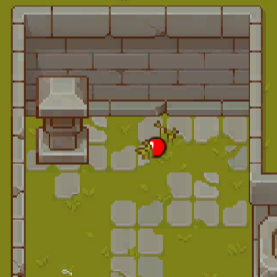
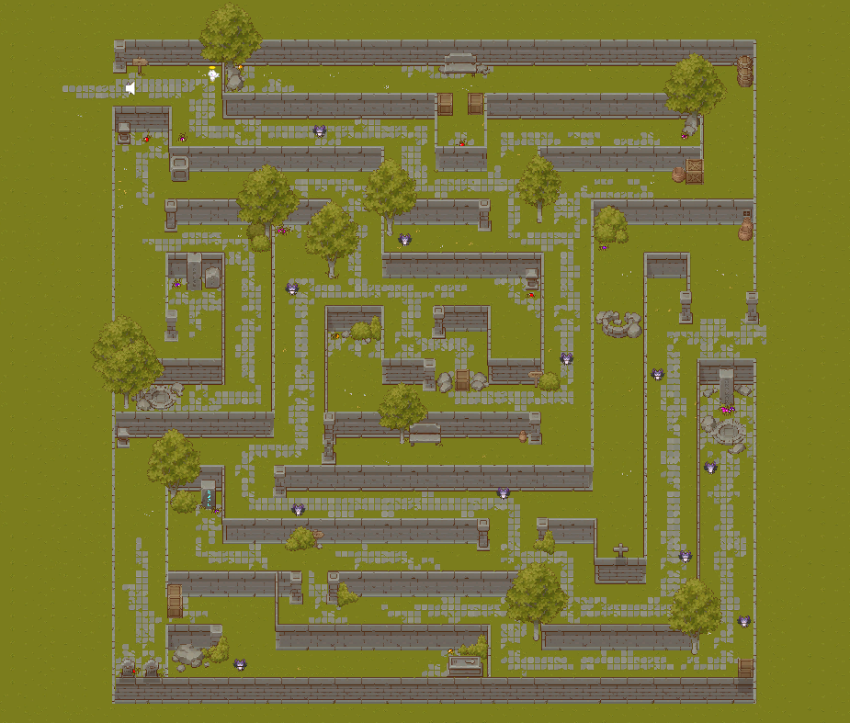
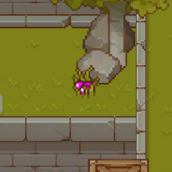
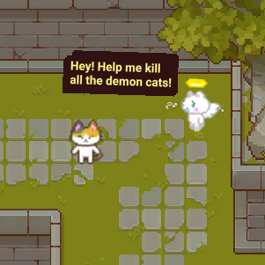
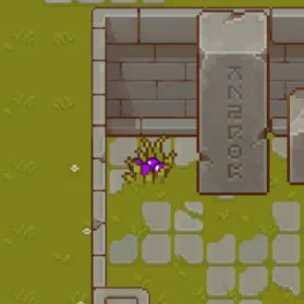
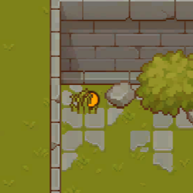
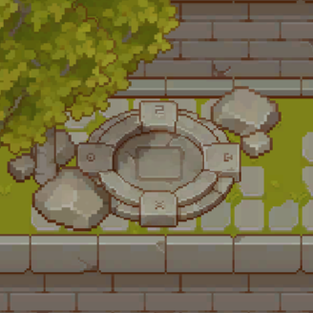
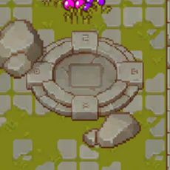
Health
Pink Bullets
Purple Bullets
Speed
Portal 1
Portal 2

Slide 9
USER INTERFACE

Slide 10
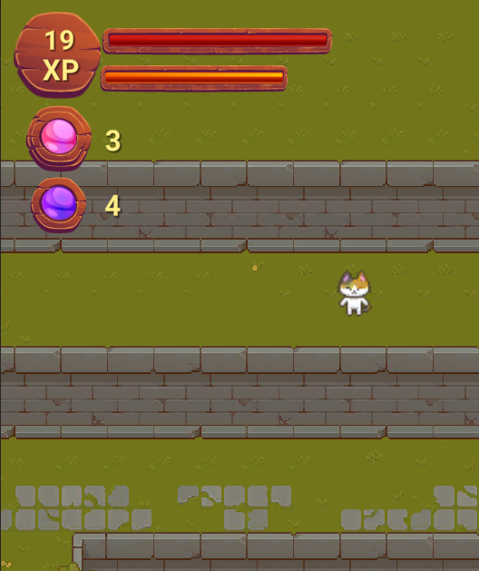
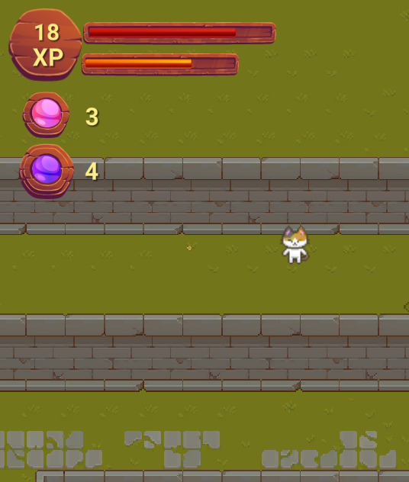
Health Bar
Speed Bar
Depleted Health Bar
Score
Depleted Speed Bar
Active Bullet

Slide 11
Speed Run Video
https://youtu.be/Rpkm8V3rd7M

Slide 12
FUTURE DEVELOPMENT
Redesign Characters
Redesign User Interface
Add Weapons and Melee Attacks
Jump and Crouch
More Complex Levels

Slide 13
THANK YOU!

